Slide 1
Illustrious
Chief data expert: Jiayuan Shen
Assistant Stat tester: Yicheng Wang
Manager with other stuff: Zijing Wang

Slide 2
Gender classification is tracible on Twitter due to sentence structure, stylistic factors, and sentiments.
Due to the gender differentiation male and female have disparate way of posting things on Twitter, we analysis
A solution which might arise from your research.
If some of the predictors can be recognized as statistically significant, which interprets the gender information whether or not positive proportional or negative proportional, we might result in a conclusion based on the research that these independent variables will predicate the gender.
This research begins to investigate the possibility of employing data visualization in gender classification.
A description of your method, part 1. We began with looking for the difference of sentence structure between male and female on Twitter.
Method pt. 2. We next look at the differences in use of link_color and sidebar_color between male and female on Twitter.
Method pt. 3. Finally, we analyze the sentiments score for males and females to figure out the association between each other.
Summary of conclusions,
We find that some fragments of the original dataset can be utilized as a primary predictor to analyze gender information. For instance, females are more subjective than males, and females are inclined to employ purple and green as the sidebar color, which males prefer grey, light blue, and white.
This research has been limited to female and male participants (there could be undefined gender, transgender, and firms on Twitter who also made profiles and comments) and data analysis only tangentially connected to a scientific situation; future research should focus on the use of these graphics and data analysis by more gender classifications posting on Twitter the or similar contexts.
Abstract

Slide 3
Twitter Gender Classification
How do male or female portray different on Twitter?
Does the sentence structure on Twitter between male and female differ? (expression, text)(Zijing Wang)
How well do stylistic factors (like link color and sidebar color) predict user gender? (Yicheng Wang)
What are the sentiment that predict male or female gender? (Jiayuan Shen)
(last_updated_at, Number of total tweets) (#galabingoclub, #game, # @)
Notes:
Men and women communicate differently in real life which naturally reflect their ways of communications in social media.

Slide 4
Codebook(Important variable from original dataset)
Text: The message that the user post through Twitter
Gender: Indicate the gender of the user
Tweet_count: number of tweets that the user has posted
Fav_number: number of tweets the user has favorited
sidebar_color: color of the profile sidebar, as a hex value
link_color: the link color on the profile, as a hex value

Slide 5
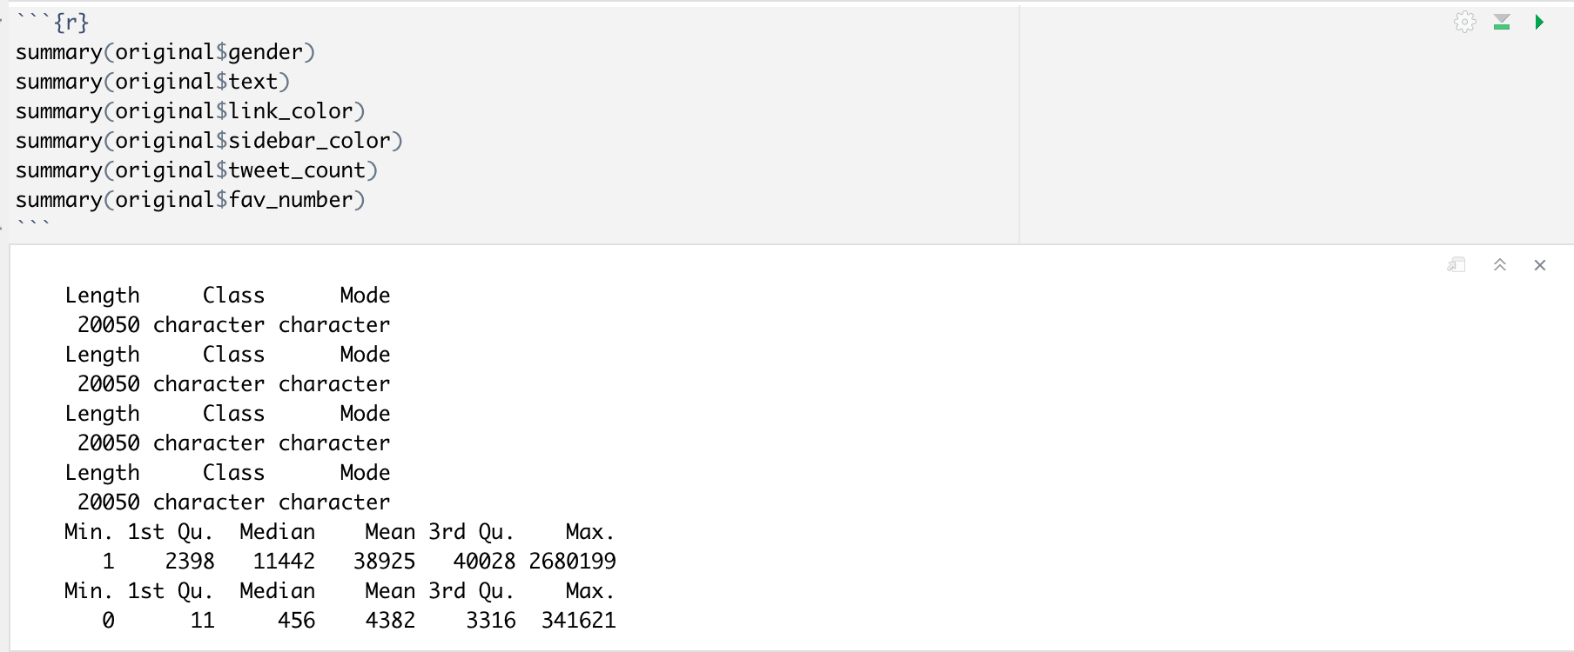
Summary

Slide 6
Research Question: Does the sentence structure on Twitter between male and female differ?
Prediction:
Sentence Structure on Twitter between male and female differ.

Slide 7
New variables that will be imported:
Word: word used in Twitter extracted from description and text.
Count: word count, frequency of usage
Count_log: log of Count
Gender: male and female
Gender_recode: 0 = female, 1=male
Word_type: nn = noun, jj = adjective, rb = adverb, vb = verb
NULL HYPOTHESIS:
Male and female have the same sentence structure.
AFFIRMATIVE HYPOTHESIS:
Male and female have different sentence structure.
Incorporating test:
Chi-square goodness of fit, logistic regression, Shapiro Wilkes test, histogram, boxplot, bar chart

Slide 8
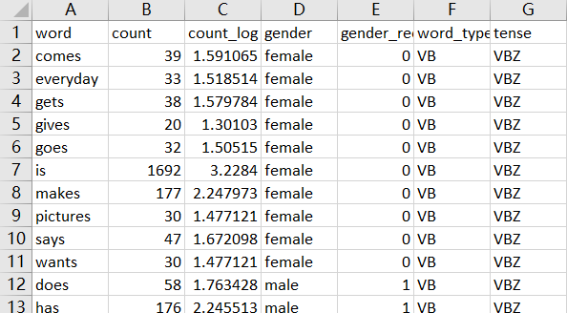
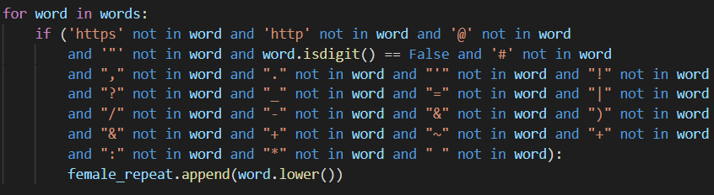
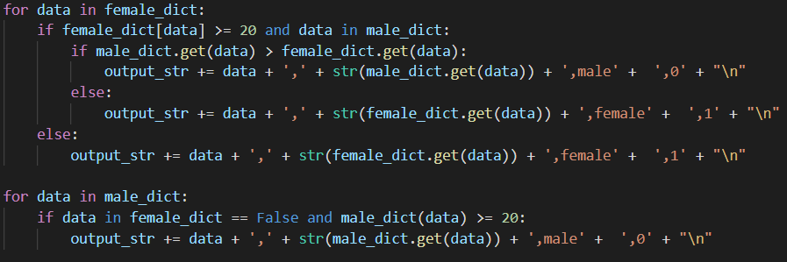
Research Question: Does the sentence structure on Twitter between male and female differ?
Cleaned Dataset
By using Python, we cleaned the data by filtering out all the non-essential strings such as numeric characters, punctuations, urls, and hashtags.
With the NLTK package, we summarized word types.
Finally, we get this cleaned dataset.
(Note that the filtering of non-essential strings does not affect the percentage of male and female fav_words’ overall percentage)

Slide 9
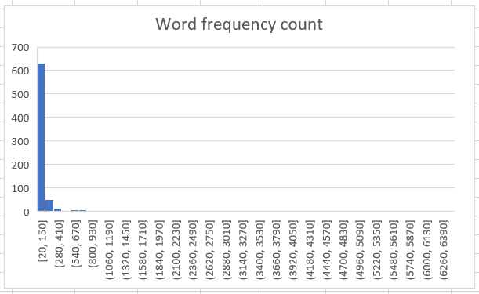
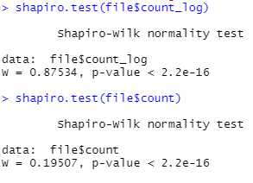
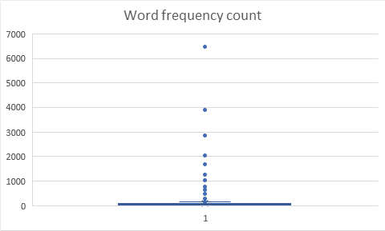
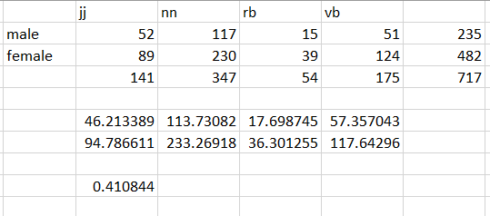
The histogram and the box plot based on word frequency shows that the it not in a normal distribution.
Shapiro-test shows that no matter the word count or the log of the word count all indicates that the word frequency is not in a normal distribution.
The chi-square test indicates the same result.

Slide 10
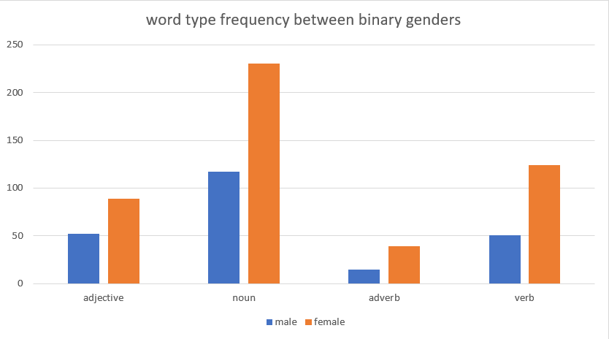
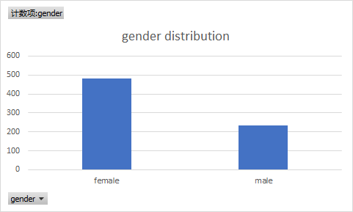
Does the sentence structure on Twitter between male and female differ?
The first ‘test’ we performed on the word frequency test is to eyeball the percentage and word distribution of word type frequency using barcharts.
It is easy to see that from the gender distribution and the word type frequency that the percentage of male and female is similar.
However, we do not think it is enough to prove that sentence structure between male and female is the same.

Slide 11
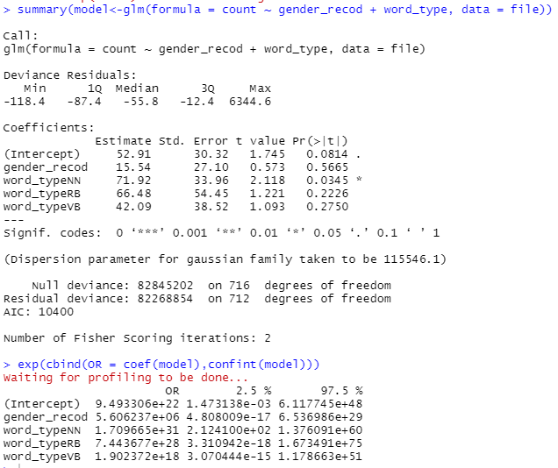
Does the sentence structure on Twitter between male and female differ?
The logistic regression of the count ~ gender_recod + word_type indicates that there are only slightly difference on the connection between variables. The differences is so close to 0 that we think it is ignorable.

Slide 12
Does the sentence structure on Twitter between male and female differ?
RESULT
According to different test results, we first proved that the word frequency dataset is not in a normal distribution. And by eyeballing the data distribution and logistic regression, we failed to reject the null hypothesis of male and female use the same sentence structure on Twitter. Thus, we believe that the sentence structure on Twitter between male and female does not differ.

Slide 13
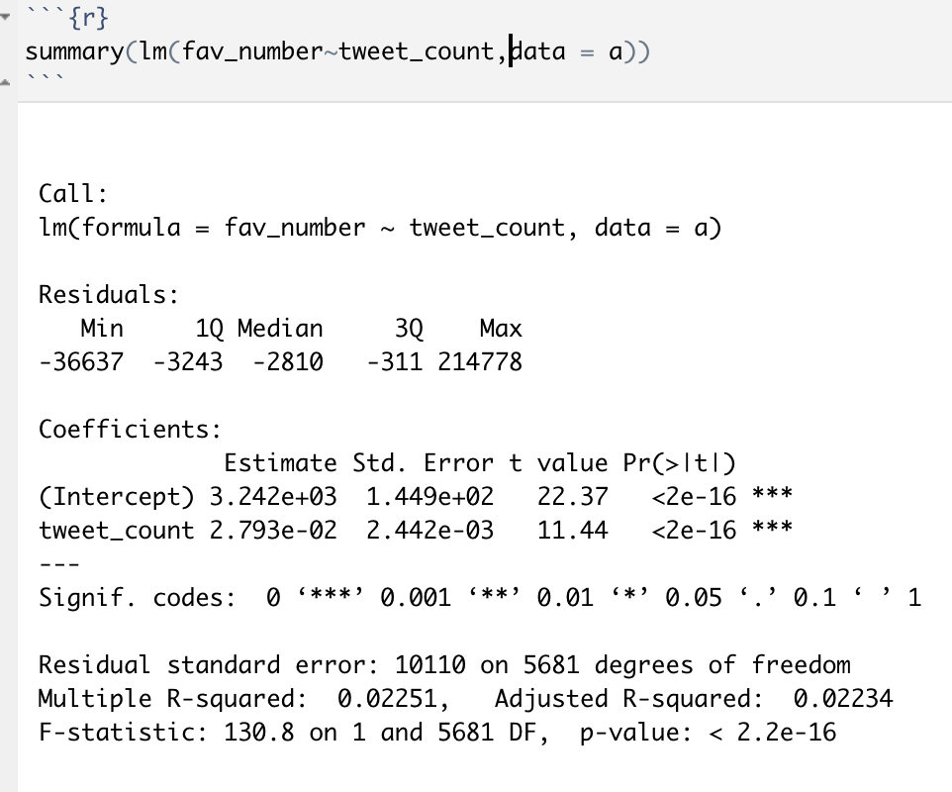
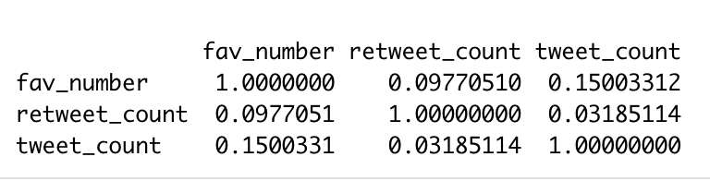
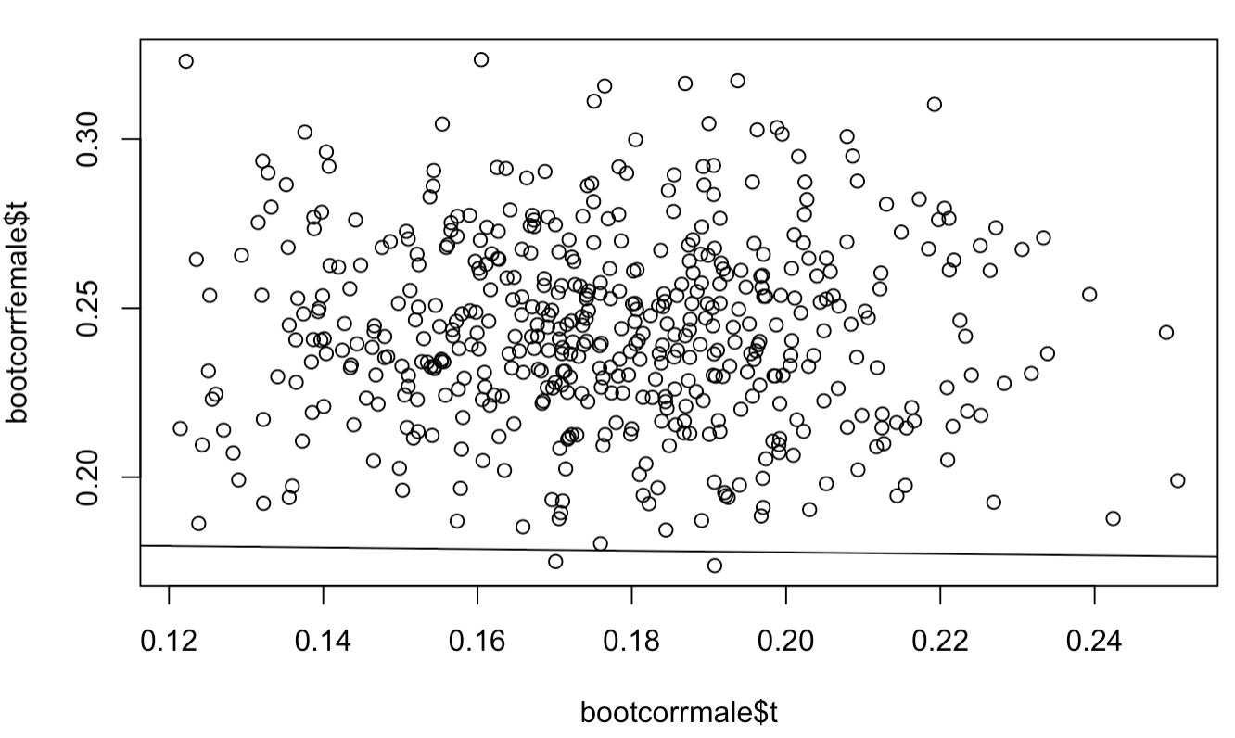
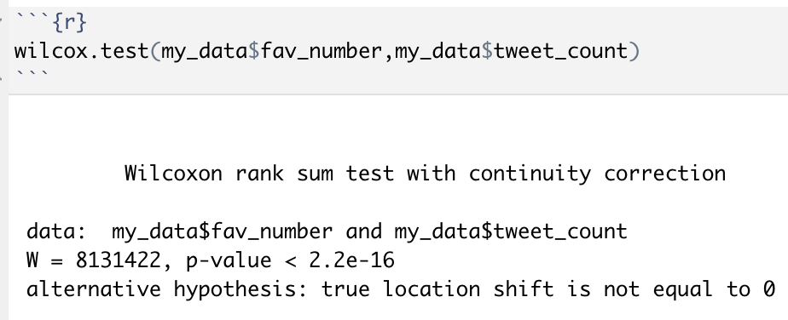
Furthermore, we also got an individual scatter plot combined with a regression line to exam the relationship between those two samples. We also have a linear regression to determine the individual impact of multiple independent variables on a dependent variable and a correlation matrix that indicate the relationship between those variables. Finally, Mann-Whitney U-test is a tool in assisting us to figure out that the two-sample have different medians.

Slide 14
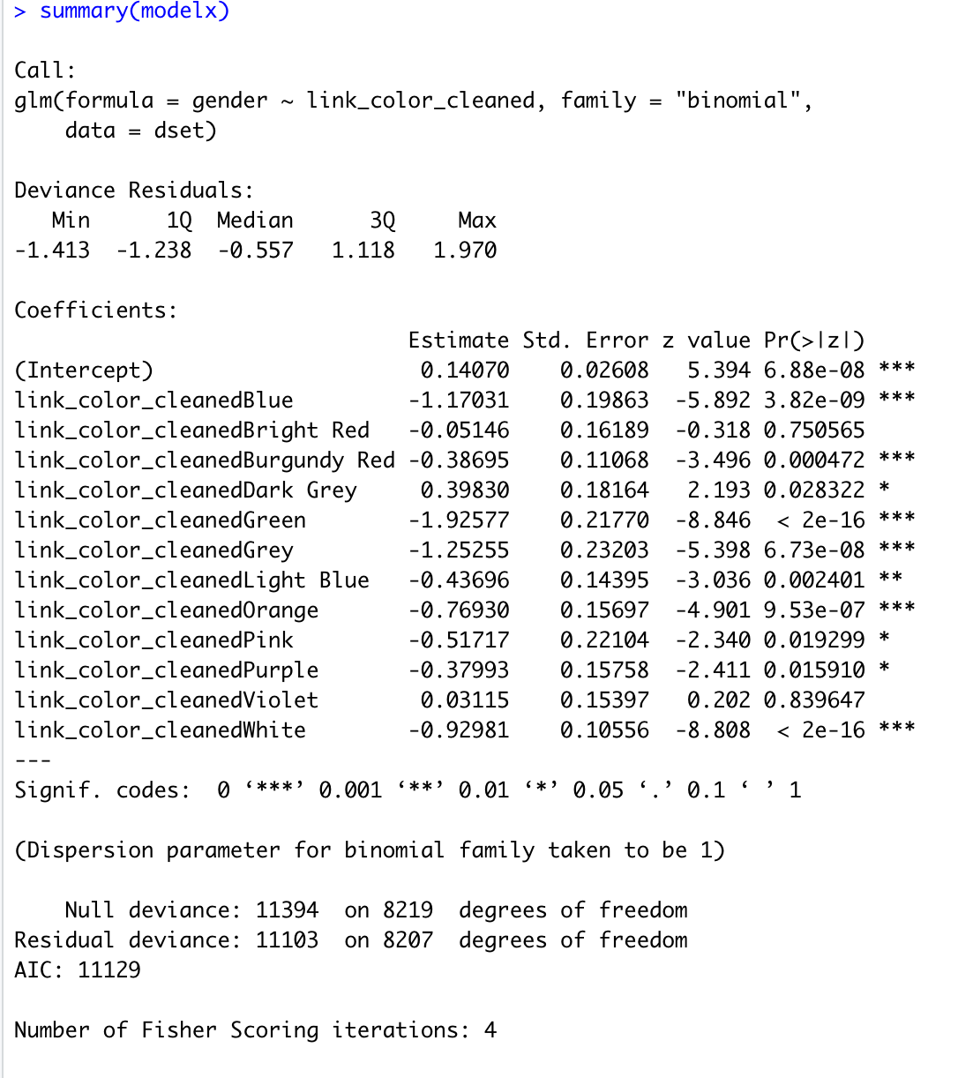
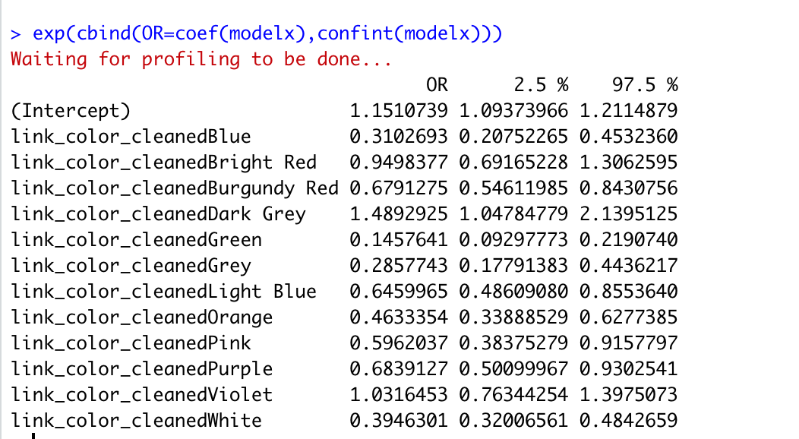
Link color
According to our regression logistic analysis, color blue, green, grey, orange, and white are statistically significant related to male users while color bright red, burgundy red, dark grey, light blue, pink, purple, violet are more statistically significant related to female users for link colors on Twitter.

Slide 15
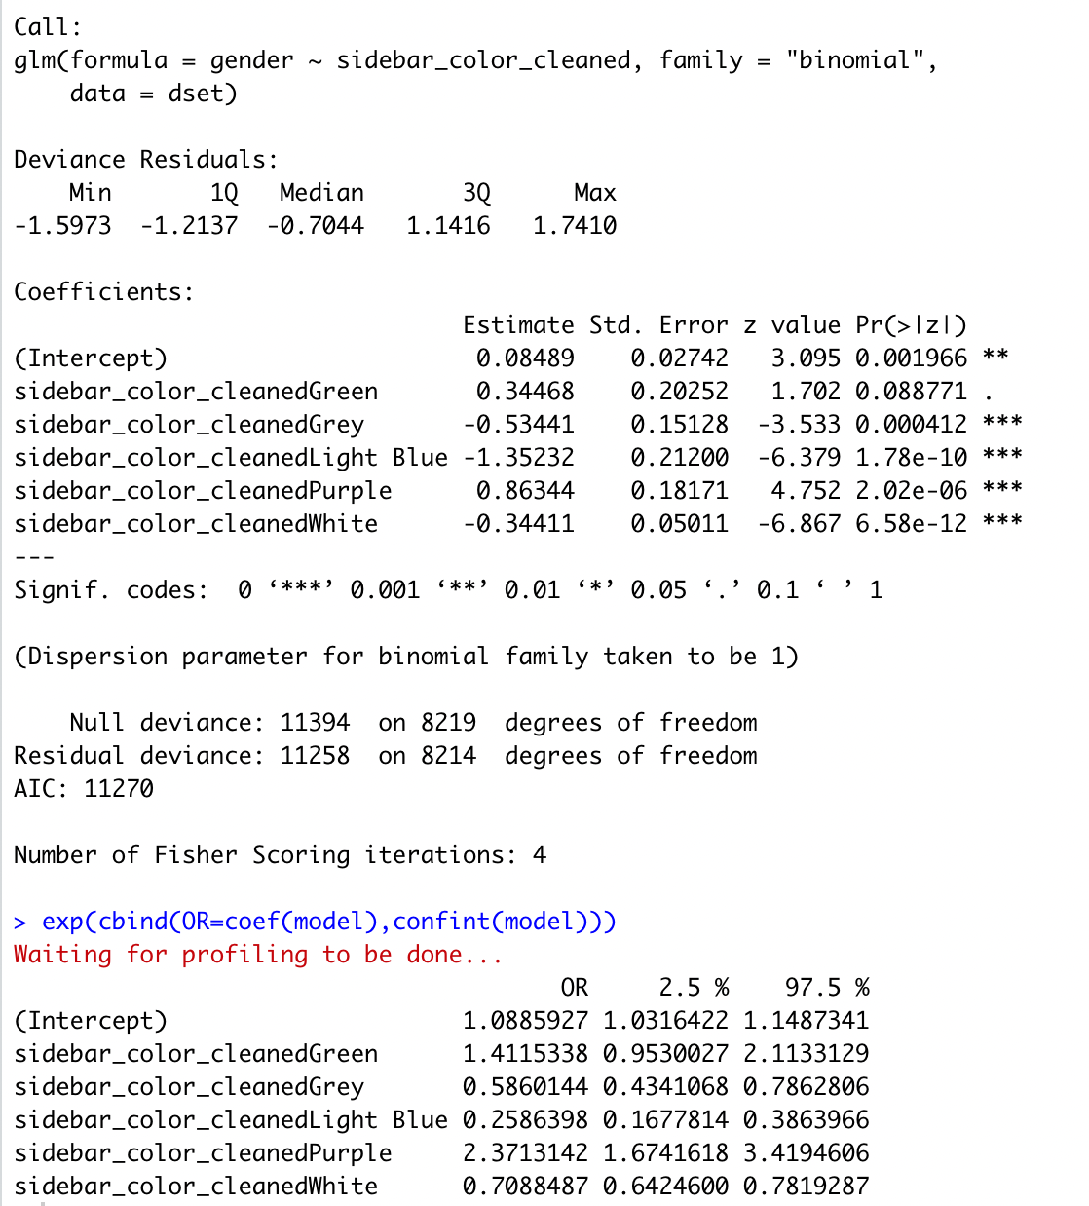
Sidebar color
According to our regression logistic analysis, grey, light blue and white are statistically significant related to male users while other colors are more statistically significant related to female users in choices for sidebar colors.
In conclusion, males are more likely to use grey, light blue and white for their sidebar while females are more interested in green and purple.
We recode the gender female as 1, gender male as 0. Thus, results in exp function closer to 0 stand for male preference; results in exp function closer to 1 stand for female preference.

Slide 16
Research Question: What are the sentiment that predict male or female gender?
Prediction:
Male’s sentiment score will be greater than female’s
We will also find:
Do male and female have the same fav_number?
Do male and female have similar variability in fav_number?
Does sentiment affect fav_number?
What is the relationship between gender and fav_number?

Slide 17
New variables that will be imported:
Polarity: a numerical variable between -1 to 1. (-1-0:negative,0: netural, 0-1: positive)
Subjectivity: a numerical variable between 0 to 1. (0-0.5: objective, 0.6-1: subjective)
Log.fav: The log format of the fav_number
Gender_recode: 0 = female, 1=male
NULL HYPOTHESIS:
male’s sentiment = female’s sentiment
AFFIRMATIVE HYPOTHESIS:
male’s sentiment > female’s sentiment
Incorporating test:
F-test, T-test, Linear regression, logistic regression, Shapiro Wilkes test, ANOVA, Tukey's Post-hoc test, Qqline, Qqplot, Density plot, Individual scatterplot, histogram, regression line

Slide 18
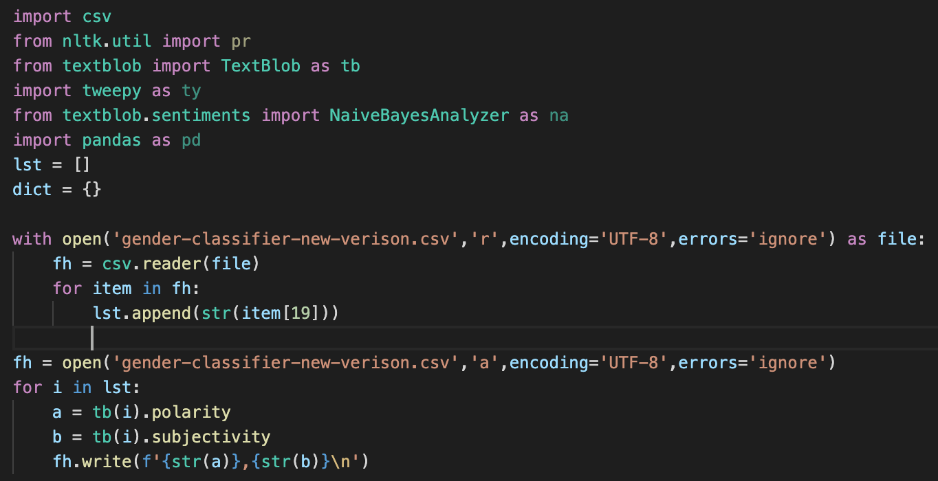
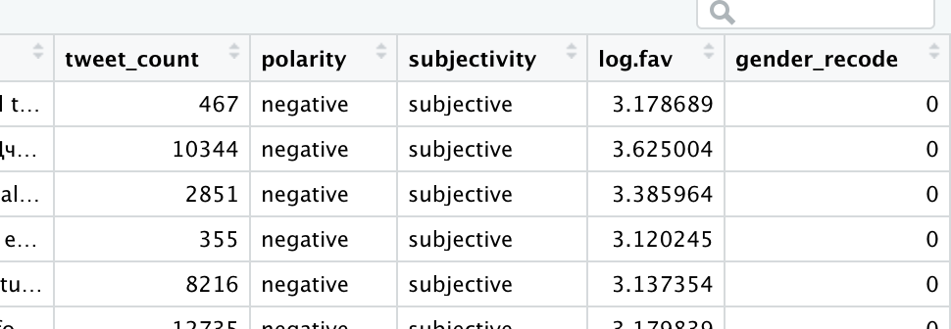
Research Question: What are the sentiment that predict male or female gender?
We import an external library from python to calculate the sentiment of the text column.
The external library contains two parameters to indicate the sentiment score, which can be partly attributed to polarity and subjectivity. Therefore, we create two additional columns to the dataset in assisting us to analyze the sentiment of males or females.

Slide 19
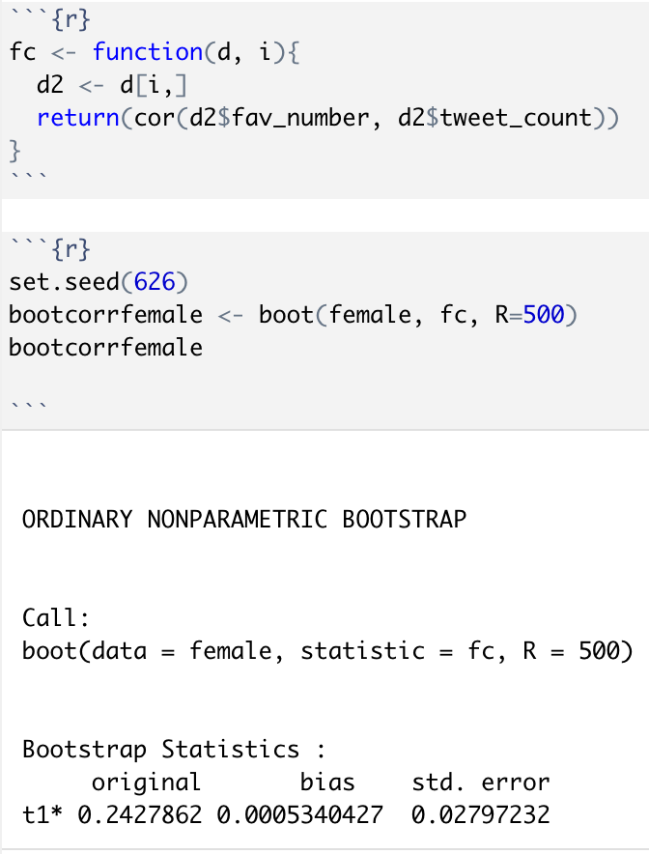
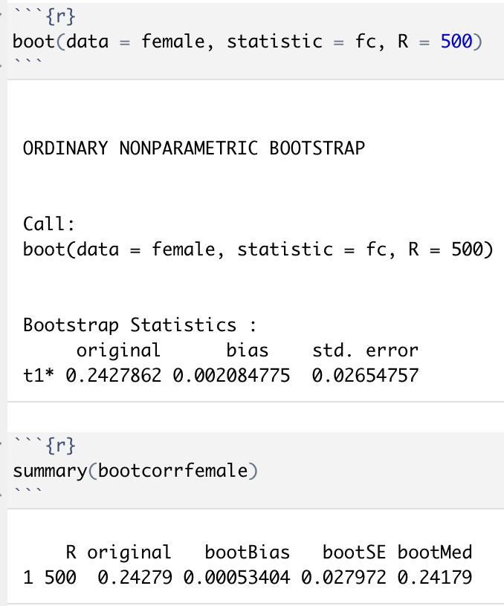
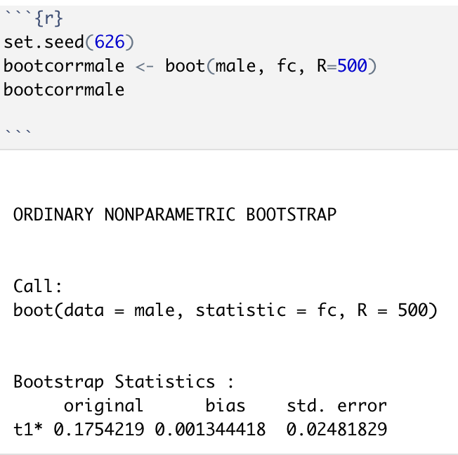
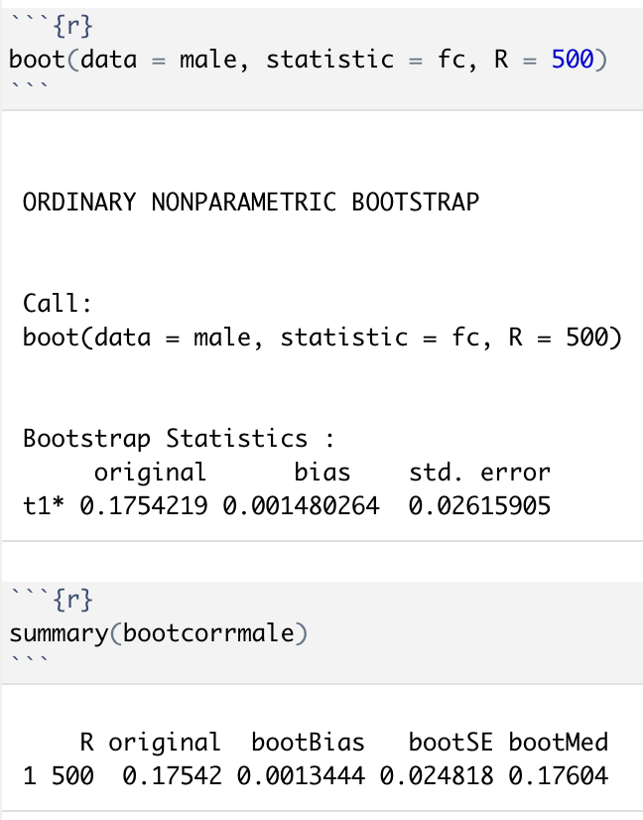
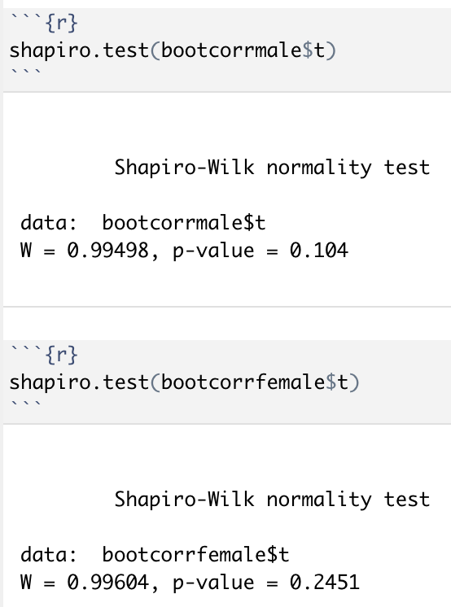
Separate the gender to male and female, and exert the boot test to extract the data of fav_number to do the t-test and f-test for question:
Do male and female have the same fav_number?
Do male and female have similar variability in fav_number?
Using Shapiro.test to test whether or not the data is the normal distribution.

Slide 20
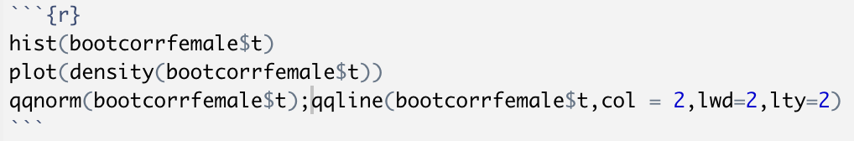
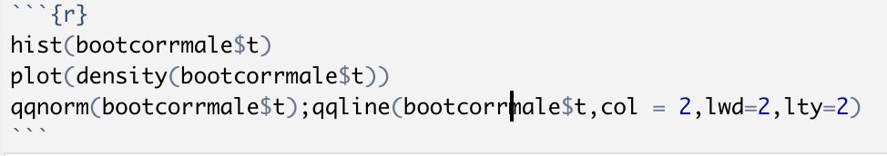
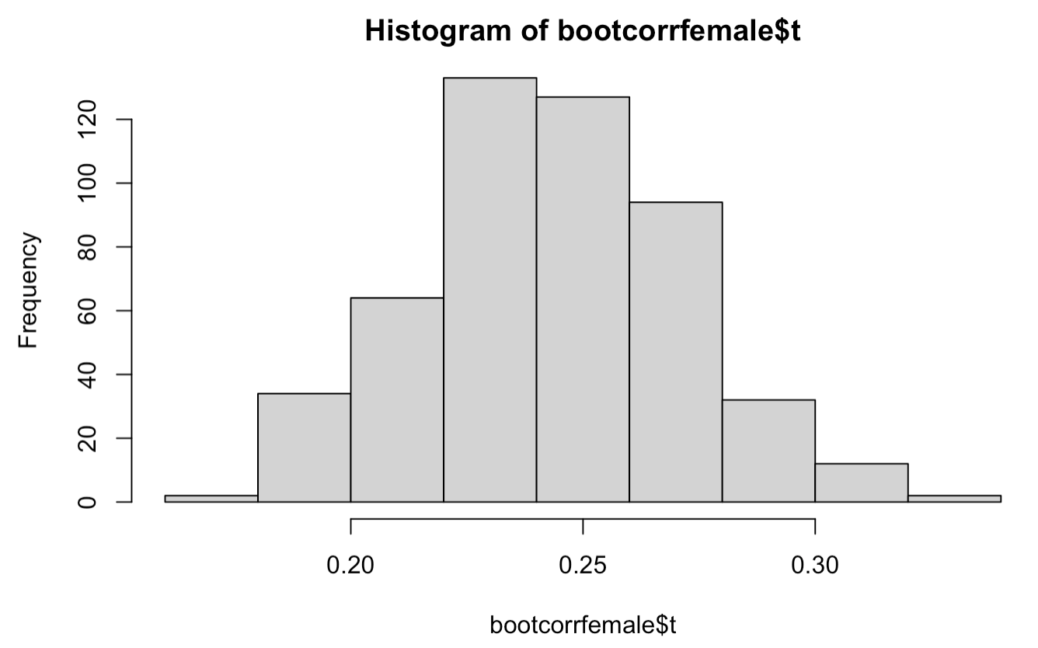
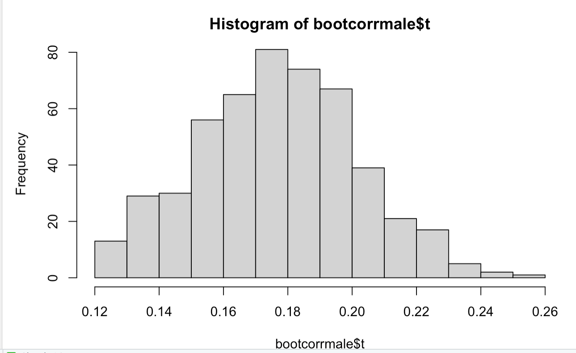
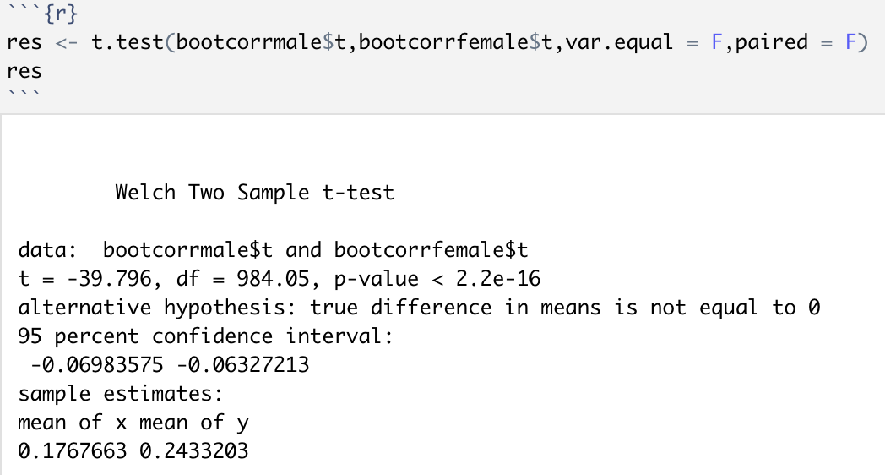
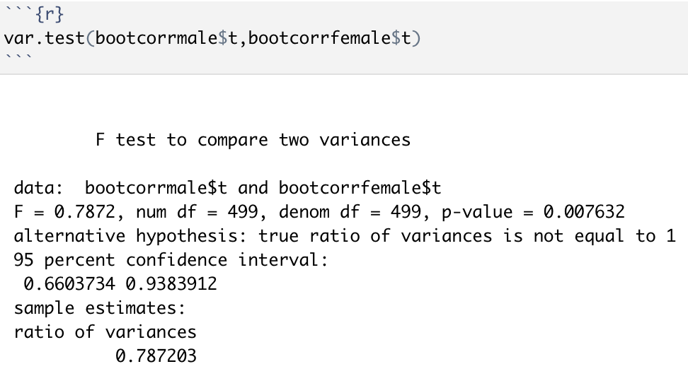
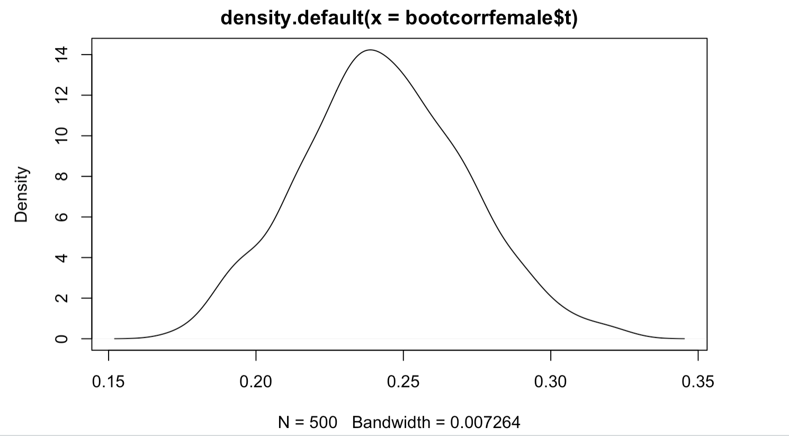
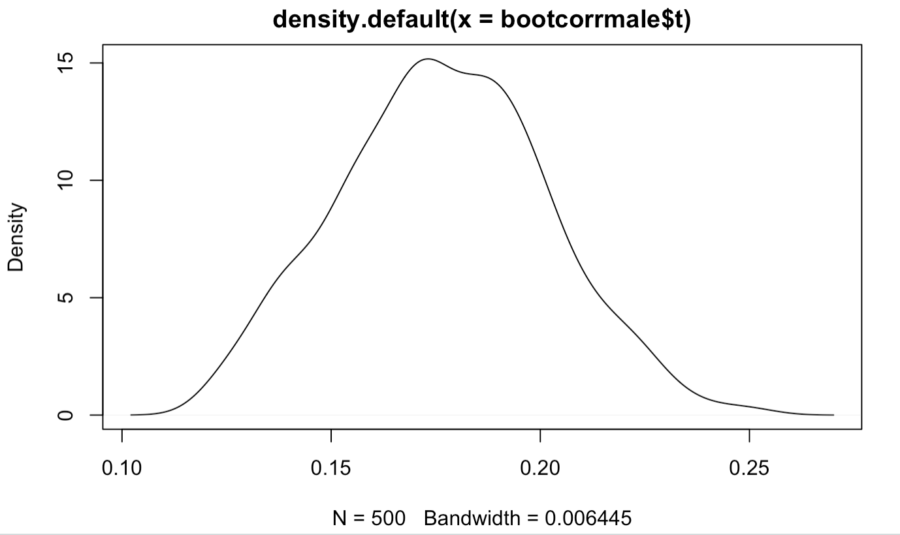
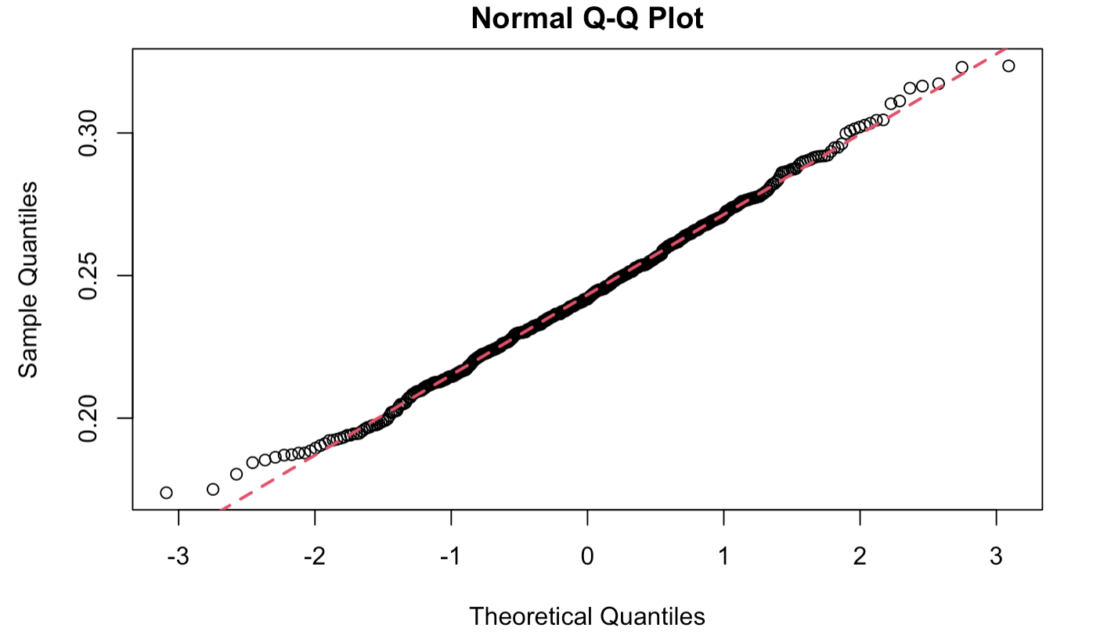
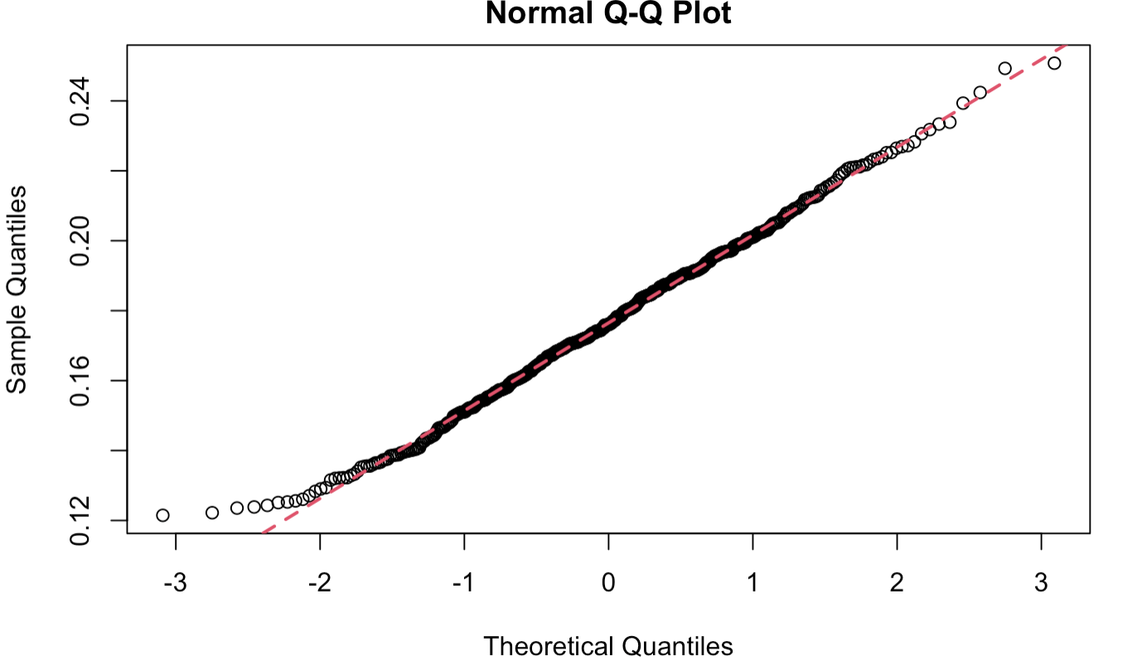
Double-check the normal distribution through histogram, Qqline, Qqplot, Density plot. After that, do the t-test and f-test in order to get the answer to the aforementioned two questions:
Male and female do not have the same fav_number
Male and female do not have similar variability in fav_number

Slide 21
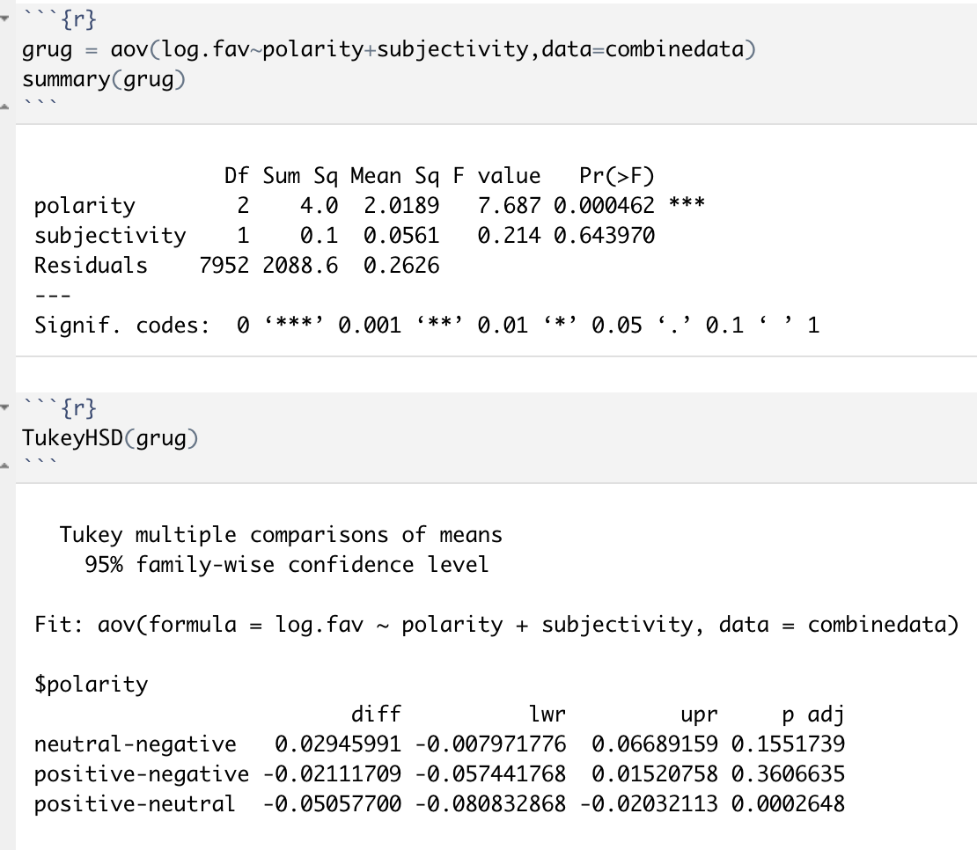
We utilized the ANOVA test to analyze how categorical variables will affect the numerical variable in this figure. Furthermore, answer the question about does sentiment affects fav_number. We can conclude that polarity or part of the sentiment will significantly affect the log.fav(fav_number), and positive-neutral matters.

Slide 22
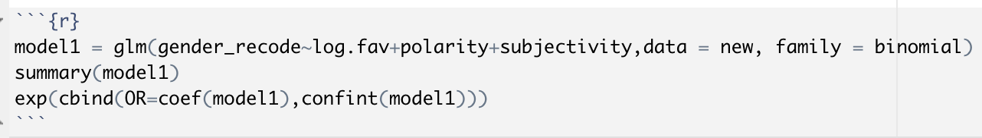
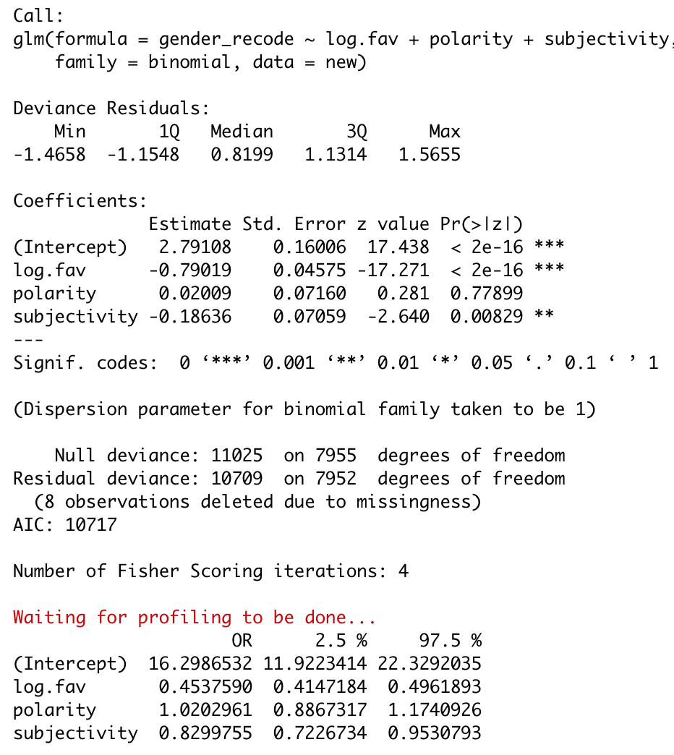
We utilized logistic regression to answer the last two questions.
In terms of the figure, we could observe that log.fav(fav_number) and subjectivity are statistically significant predictors of gender.
Females are 0.45 times more likely to increase the number of tweets the user has favorited than males.
On Twitter, females are 0.83 times to be more subjective than males.

Slide 23
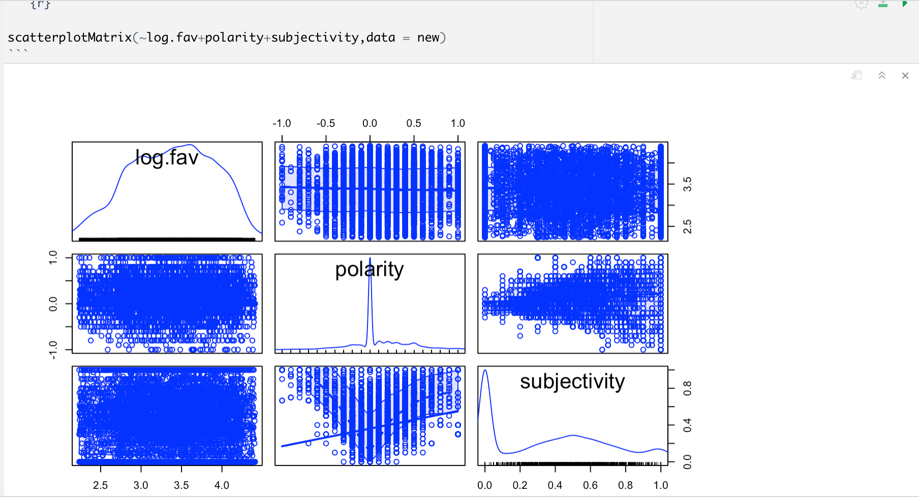
We also create a scatterplotMatrix in order to find the correlation between those independent variables. However, the independent variables do not have correlations with each other

Slide 24
RESULT
We expect to observe that the females’ sentiment score will be greater than males’, however, since the subjective is the part of the sentiment score and the polarity cannot be attributed as statistically significant predictors, and we actually find that males are more objective than females. Therefore, we reject the null hypothesis.

Slide 25
Link to the original data set
https://www.kaggle.com/crowdflower/twitter-user-gender-classification

